Slide 1

Heart Failure Predictions
By Shelly-Ann Duncan

Slide 2
Dataset
A combination of different of independent datasets combined.
The target Heart Disease in male and female
Eleven different features that are associated with heart disease/failure.

Slide 3
How can we predict Heart disease
These are the input features that were used for the predictions.
Age: age of patient [years]
Sex: sex of the patient [M: Male, F: Female]
ChestPainType: chest pain type [TA: Typical Angina, ATA: Atypical Angina, NAP, Non-Anginal Pain, ASY: Asymptomatic]
RestingBP: resting blood pressure [mm Hg]
Cholesterol: serum cholesterol [mm/dl]
FastingBS: fasting blood sugar [ FastingBS>120 mg/dl
RestingECG: resting electrogram results [Normal, ST: having ST-T wave abnormality (T wave inversions and/or ST elevation or depression of >0.05mV), LVH: showing probable or definite left ventricle hypertrophy be Estes criteria]
MaxHR: maximum heart rate achieved [numeric value between 60 and 202]
ExerciseAngina: exercise-induced angina
Oldpeak: ST[numeric value measured in depression]
ST_Slope: the slope of the peak exercise ST segment [upsloping, flat, downsloping]
Heart Diseease: output class[heart disease, normal]
Age: age of the patient [years]cc
Sex: sex of the patient [M: Male, F: Female]
class [1: heart disease, 0: Normal]

Slide 4
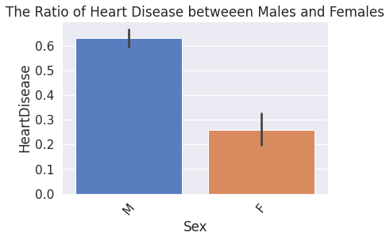
Data visuals
According to visual, there are a significantly more males than females with heart disease.

Slide 5
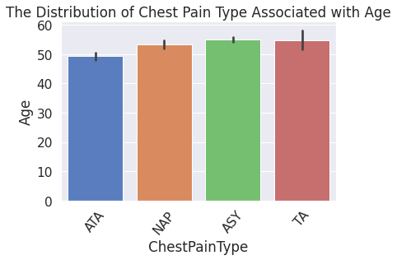
Data visual 2
According to this visual, persons who are 55 and over both experience the Asymptomatic (no signs of heart issues) and Atypical Angina (shortness of breath, discomfort in the throat, jaw, neck) pain type.

Slide 6
Models used to Predict Heart Disease in Machine Learning
To predict Heart Disease: Classification; heart disease or normal.
Multiple models used for predictions: Decision Tree, KNeighbors, Logistic Regression. Tuned with GridSearchCV to improve model performance.
Model prediction speed: PCA
Baseline model Kneighbors had 88% accuracy. Chosen model for predicting heart disease.

Slide 7
Why the KNeigbhbors KNN
Kneighbors uses the most similar observations to make predictions.
Easier to understand but predictions can take a long time with large data. Also, can have a bad performance.

Slide 8
Recommendations
With this dataset I recommend that medical professionals focus on letting their patients know that even though they may feel fine, they need to pay attention to their health as they may not experience symptoms, they can still be at risk.
There should also be a focus on their male patients because they are at higher risk for heart disease.
Consider adding a few more features such as “eating habits,” “weight,” etc.

